Slide 1

Mobility
Alex Mariakakis
University of Toronto
Department of Computer Science

Slide 2
Why Care About Mobility?
Leverage trends across communities to understand population-level trends
Urban mobility and access to green space
Epidemic monitoring and contact tracing
Community-level predictors of long-term health

Slide 3
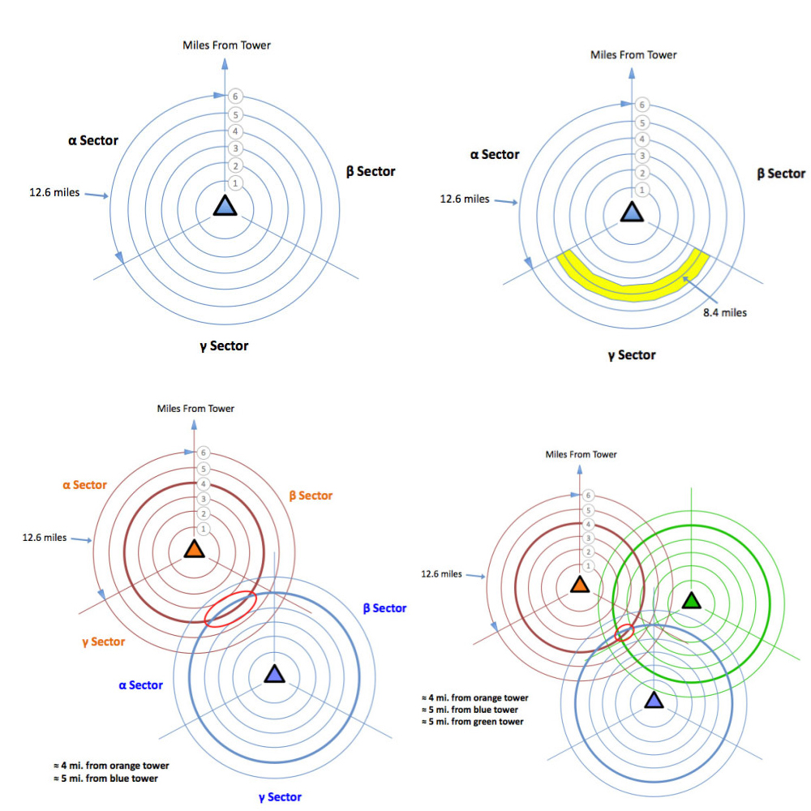
How Can We Get Mobility Information?
Cell tower triangulation
Distance from single tower is calculated using signal strength and round-trip time (RTT)
One tower will get your rough location within a “sector”
Three towers needed for precise location
Often a combination of triangulation (using angles) and trilateration (using distances)

Slide 4
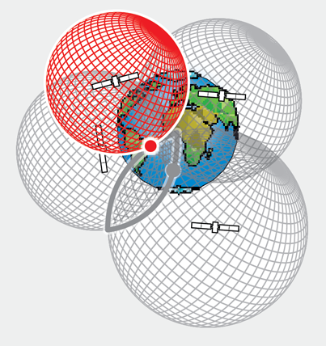
How Can We Get Mobility Information?
GPS
Similar to cell tower triangulation
Requires four satellites to calculate (x, y, z, time)

Slide 5
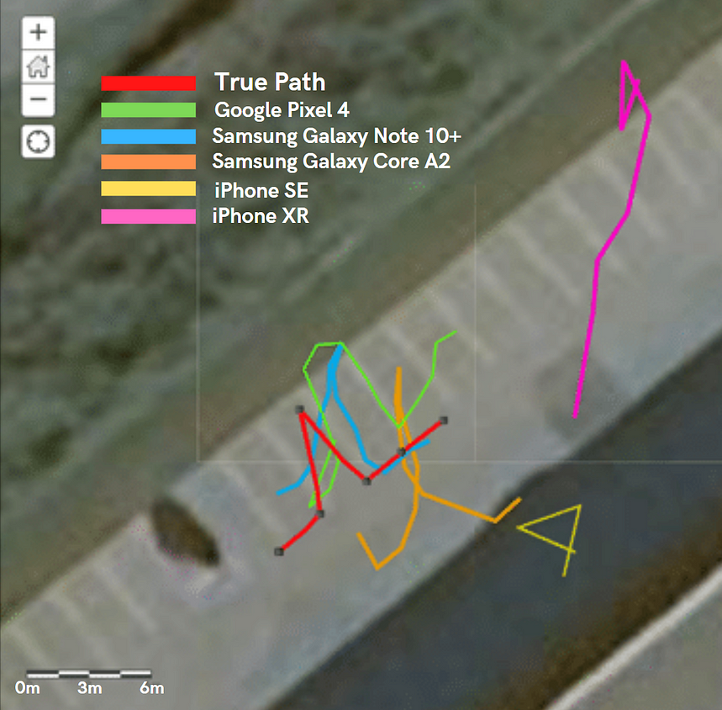
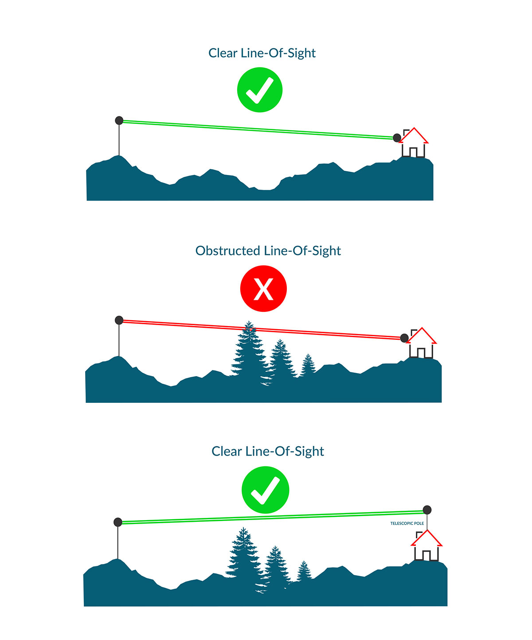
What About Indoors?
Typical accuracy is 5–30 meters
Distance measurements using wireless signals assume line-of-sight
Lots of environmental obstructions from trees, buildings, etc.
Obstructions → poor signal strength → inaccurate distance measurements
Indoor localization is a task of its own

Slide 6
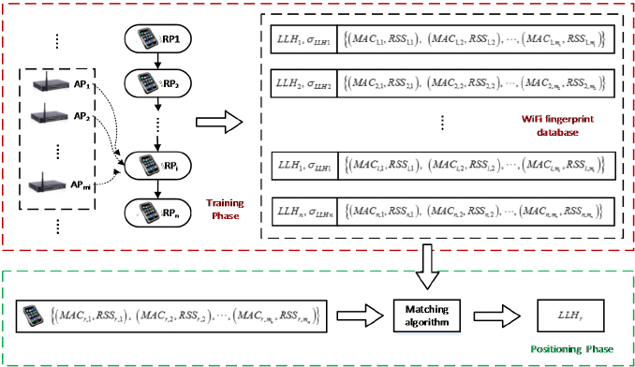
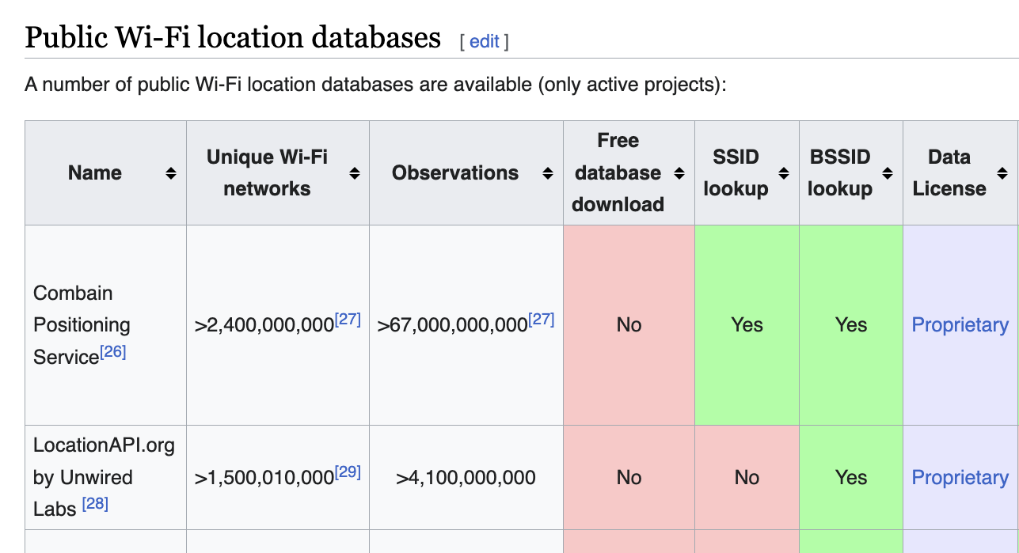
How Can We Get Mobility Information?
Wi-Fi
Wi-Fi access points are used to locate devices
Trilateration: Distance-based measurements
Fingerprinting: Each location has a signature of nearby access points and signal strengths
Devices are used to locate Wi-Fi access points
Companies like Google and Apple maintain tables that map Wi-Fi networks to locations

Slide 7
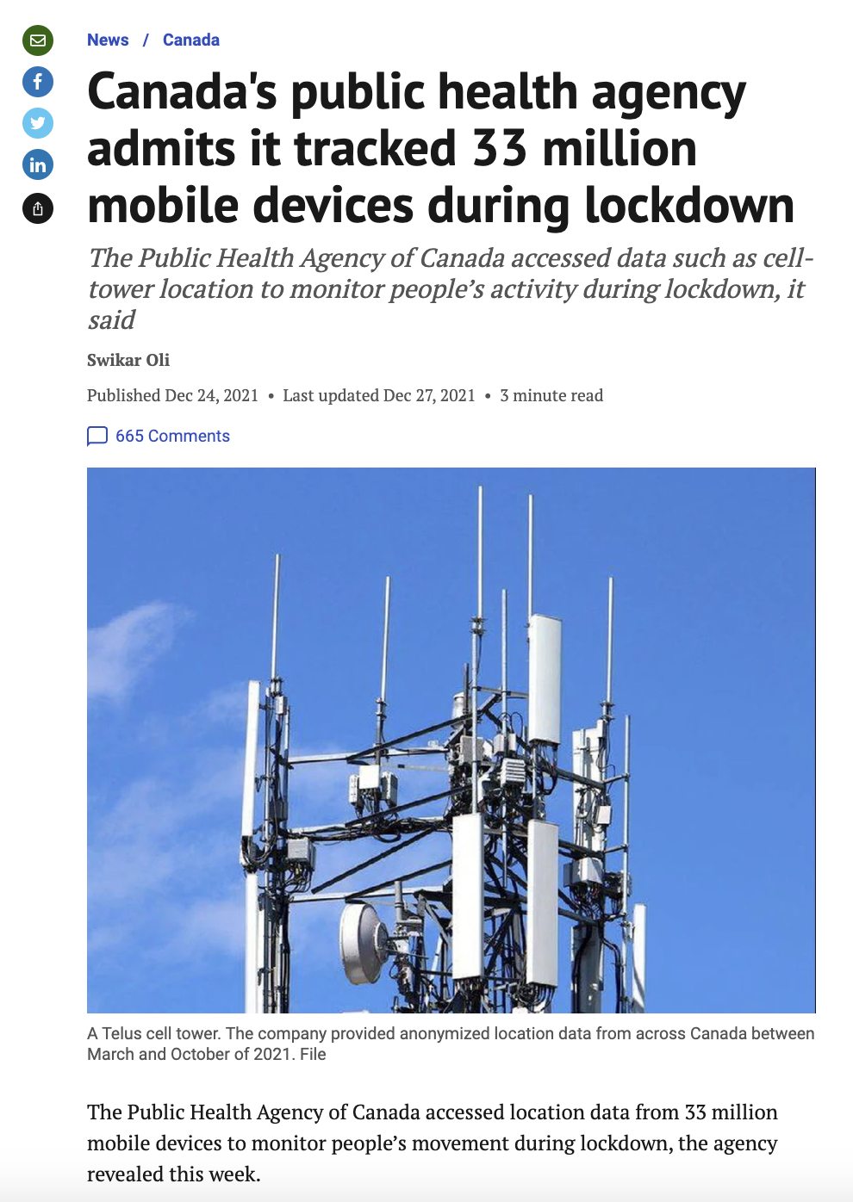
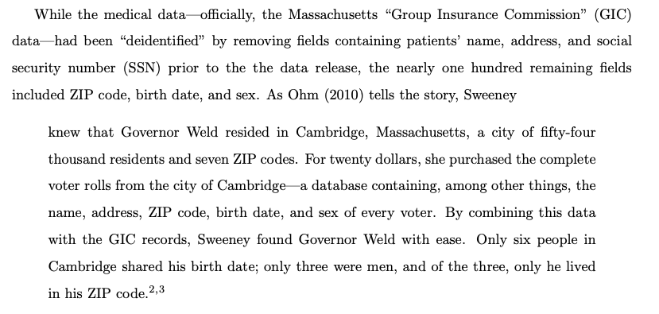
Privacy Considerations
Location data is used by many government agencies and companies (ideally de-identified)
De-identification is often not enough

Slide 8
Resources
Cell Tower Triangulation (GPYes ‘23)
We Tested Mobile GPS/GNSS Accuracy and Found Some Surprising Results (!important Safety Technologies)
Privacy and Data-Based Research (Heffetz and Ligett ‘13)

